Slide 1


RURALRIVER · THE HIDDEN HEAVEN
A village has houses,
land and people.
We put all three to work.
A local host business in San Xoán de Río, Terra de Trives, Ourense: stays in its houses, private events on its land, and multi-year leases of its abandoned parcels to agricultural projects.
Hackathon pitch · September 2026 · every figure on these slides is read live from the app (/api/model)
Notes:
Fifteen seconds. Say the name, say the village, say the line. Do not explain the logo; it is an R with the river running through it and the valley at its foot.
SAY: A village has houses, land and people. We put all three to work.

Slide 2





THE PROBLEM
Spain has empty villages and abandoned land.
510
≈61
35.7%
1.7 M
residents in San Xoán de Río today, down from 3,000+ in the 1980s
average age in the village; nearly half of the neighbours are over 65
of Galicia's farmland is unused or abandoned, the highest share in Spain
owners of rural land in Galicia, against about 44,000 people who farm it
The Xunta's own answer in this municipality, the Cambela polygon, needs 135 owners to agree on 96 hectares. Ownership is the bottleneck, not the land.
Sources: Wikipedia and idealista (population, age) · El Correo Gallego citing MAPA, 20 Mar 2026 (unused farmland) · El Correo Gallego, 20 Sep 2026 (owners)
Notes:
Thirty seconds. Two numbers about the village, two about the land. The land numbers are the new ones: a third of Galicia's farmland is unused, and there are forty owners for every person who farms.
The 35.7% figure is Ministry of Agriculture data reported in March 2026; the 1.7 million owners figure is from September 2026.

Slide 3
THE INSIGHT
The village isn't short of assets. It's short of a host.
Empty stone houses. Parcels nobody has touched since the 2000s. Cooks, guides and musicians with nobody booking them. A public land polygon waiting for 135 signatures.
So the assets sit idle, and visitors come for a weekend.
Notes:
Thirty seconds. Slow down on this slide. The whole pitch is here: the village is not poor in assets, it is poor in hosts. Pause after the last line.
SAY: So the assets sit idle, and visitors come for a weekend.

Slide 4


THE SOLUTION
One local host puts every resource to work.
Stay
Celebrate
Farm
Packages of a week, a month or a season. Our stone house let whole; villagers' houses at a 15% commission.
Birthdays, retreats and magostos on villagers' land, groves and cellars, with local cooks and musicians.
Villagers' abandoned parcels leased for 5 to 25 years to chestnut, organic, cattle and beekeeping projects.
from €220 per person
≈€2,000 per event
≈€172/ha a year + fees
Every product pays a villager first: 85% of a house rent, 80% of a venue fee, 85% of the land rent. We never own the land.
Packages are per person for experiences; lodging is booked with the owner · leases follow Ley 49/2003 (5 years minimum)
Notes:
Forty seconds. Three products, one host. Stay pays the first months, Celebrate uses the land in summer, Farm is the one that lasts: five to twenty-five years.
Say the bottom line word for word: every product pays a villager first, and we never own the land.

Slide 5




THE PRODUCT
What a project pays for, and what a guest pays for.
Parcels found, heirs abroad located, owners consolidated into one lease
A PROJECT SET-UP, ONE-OFF
€1,500
Rural lease drafted under Ley 49/2003: 5 to 25 years, rent paid yearly
Banco de Terras, Concello and Medio Rural paperwork handled
+ €600 a year of management, + 15% of the rent. The owner keeps 85%.
Local crew recruited first; project teams housed in villagers' houses
An AI concierge that knows every parcel, route, supplier and price
A WEEK FOR A GUEST
€220
Experiences and the host only. The house is ≈€110 a night, booked with the owner. €450 for a month, €900 for a season.
Galicia's average farmland rent: €172/ha a year (MAPA, 2023) · Anceu rural coliving from €882/month · Rural Valley campus €350/month, founders only
Notes:
Thirty-five seconds. Left: the five things a project cannot do alone from a city. Right: two prices, and the reason they are separate from the bed. Lodging is always booked with the owner, which keeps us out of package-holiday law.
IF ASKED why €1,500: it is roughly a week of a gestor's and our time per project, and the Cambela polygon shows what assembling owners costs the Xunta.

Slide 6
THE LANDSCAPE
The market is validated. The lease-signing layer is missing.
Discovery platforms show rural Spain, colivings host the visit, the public land bank lists parcels. RuralRiver stays for the years in between.
Rural discovery
Stays & events
Multi-year land leases
Owner assembly
Local hiring
Revenue after arrival
AI concierge
Parcels get listed. Owners don't get assembled.
Aldealista
Holapueblo
WHY RURALRIVER IS DIFFERENT
Rural colivings
Operational, not informational
Banco de Terras (Xunta)
We find the heirs, sign the lease, pay the owners and hire the crew.
RuralRiver
Years next to nights
Week-long stays and 25-year leases from the same host: two horizons, one network.
Yes
Partial
No
Revenue after arrival
Set-up, yearly management and 15% of the rent for as long as the project stays.
Aldealista shows the village. Colivings host the visit. The Banco de Terras lists the parcel. RuralRiver signs the lease and hires the village.
Scope assessed from each initiative's public information, September 2026 · marks show what each one offers, not its quality
Notes:
Thirty seconds. Name the four as market validation, not rivals. Then one column at a time: only the Banco de Terras does multi-year leases, and it lists parcels; it does not go door to door for 135 signatures. Say the positioning line and pause.
SAY: Aldealista shows the village. Colivings host the visit. The Banco de Terras lists the parcel. RuralRiver signs the lease and hires the village.

Slide 7
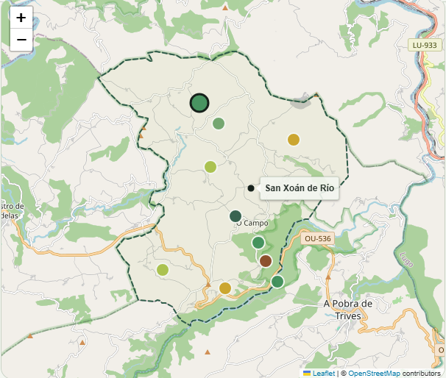
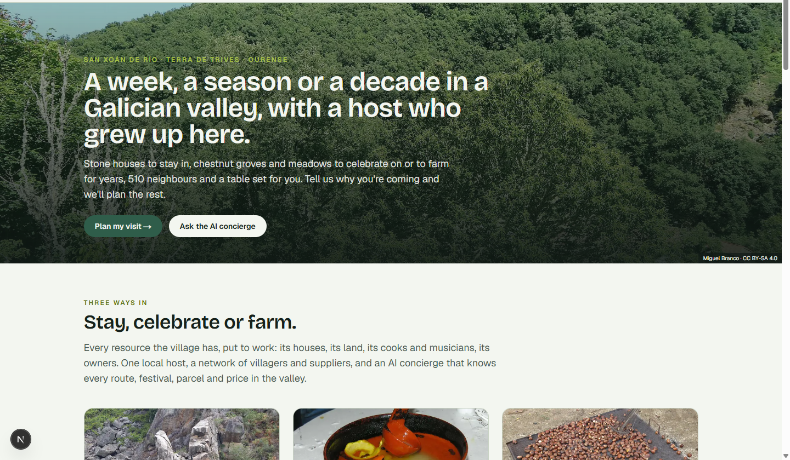
WORKING PROTOTYPE
The site runs, the map runs. The parcels are examples.
NOT BUILT YET
RUNNING TODAY
Payments, owner accounts, signed listings.
Bilingual site, guided planner, event builder, land map with 10 example parcels and a lease builder, AI concierge (offline mode), live business model.
Built in-house by the team · runs on a laptop without internet except map tiles · figures on every slide are read from /api/model
Notes:
Thirty seconds. Point at the map: the municipal boundary comes from OpenStreetMap, the ten dots are example parcels with hectares, water, access and the year they were last worked. Click one and the lease builder prices it for five to twenty-five years.
Be honest: payments and owner accounts are not built, and the parcels are examples until an owner consents.

Slide 8

THE MODEL
Three payers. A villager earns on every one.
Guests
Event clients
Project owners
€220–€900 packages, ≈€110 house nights, 15% on villagers' houses
≈€2,000 per event; the landowner keeps 80% of the venue fee
€1,500 set-up, €600 a year, 15% of the rent; the owner keeps 85%
€66,200 · 70% MARGIN
€50,000 · 32% MARGIN
€23,000 · 83% MARGIN
The guest pays for a week. The project pays for a decade. Both pay a villager before they pay us.
Margins after direct costs, from the live model · owners keep 80–85% of every rent · no council contract in the model
Notes:
Forty seconds. Guests pay for the first months, events carry the summer, projects pay every year. Point out that the land margin is the highest because the owner is paid out of the rent, not out of our fee.
Shares of year-one revenue: guests 48%, events 36%, land 17%.

Slide 9



YEAR ONE
One village. €139,200 revenue. Loan repaid, €58,274 profit.
REVENUE
PROFIT AFTER ALL COSTS
CASH AT MONTH 12
€139,200
€58,274
€63,274
On €25,000 in: €5,000 savings and a €20,000 loan at 7%, repaid inside the year at €1,731 a month (€20,766 in total). Revenue left after the loan: €118,434. The year stays profitable down to 29% of the planned volumes.
Before founder pay · all volumes are our estimates · seasonality Oct 2026–Sep 2027 · sliders at /business
Notes:
Forty-five seconds. Revenue, profit, cash. Then the loan: twenty thousand at seven percent, repaid inside the year, and the business is still profitable at twenty-nine percent of plan. Volunteer that founder pay is not in the figure.
Revenue after full loan repayment: €118,434. Breakeven volume factor: 0.29 of plan (€40,070 revenue).

Slide 10
YEAR ONE · ONE VILLAGE
OWNERS PAID EVERY YEAR
THE LOAN
10 projects on 40 ha
85% of the land rent
repaid in 12 months
Airbnb helps people stay.
RuralRiver helps a village work.
A village already has houses, land, cooks and musicians. What it does not have is someone to put them to work. We are that someone.
Notes:
Forty seconds. Say the three facts quickly, then the two lines, then stop talking. Silence after the last line is the strongest thing you can do.
SAY: Airbnb helps people stay. RuralRiver helps a village work.

Slide 11
BACKUP
Twelve slides for twelve questions.
Not part of the five minutes. Jump straight to the one that answers the question asked.
Notes:
Not part of the five minutes. Jump straight to the one that answers the question asked.

Slide 12


BACKUP 1
“Isn't this just rural tourism?”
TOURISM
RURALRIVER
Days, not years
Leases of 5 to 25 years
Sells an escape
Sells a village that works
Revenue ends when they leave
Revenue every year the project stays
Village gets a visitor
Village gets rent and jobs
Stays and events pay the loan in the first year. Land leases are what remain in year five: the owner is still paid, the crew is still hired, and we still manage the lease.
52% of Year 1 revenue comes from villagers' land: events on it and leases of it
Notes:
Stays fund the first months. The land is what lasts: a lease runs five to twenty-five years, and every euro of venue fee and land rent goes eighty to eighty-five percent to the owner.

Slide 13
BACKUP 2
“Why €220 and not more?”
OFFER | PRICE | INCLUDES
Rural Valley campus, same village | €350 / month | Housing, meals, gigabit, mentoring; founders only, one year
Anceu Coliving, rural Galicia | €882 / month | Room, coworking, fibre
Group houses, Ourense province | from €15 / person / night | Four walls
RuralRiver · Discover Trives | €220 / week | Guided walk, canyon, winery, dinner, concierge; house booked with the owner
RuralRiver · A season here | €900 / 3 months | Weekly activities, introductions, desk, first look at parcels
We sell the week, the season and the years. The bed is the owner's business, at the owner's price.
Sources: Somos Comarca (Rural Valley) · anceu.com · EscapadaRural (group houses in Ourense) · our prices are estimates
Notes:
Our price is for what the village does with you, not for the bed. Beds belong to the owners at market prices, which keeps us out of package-holiday law and keeps the owners paid.

Slide 14



BACKUP 3
“Rural Valley charges €350 in the same village.”
Proof of demand
It has an exit date
120 warm leads a year
A village of 510 people is betting public money on attracting 120 entrepreneurs a year. The market is already validated.
A subsidised one-year cohort for founders only. No land, no events, no housing after.
Guests, event clients, and agri-food founders who need parcels, arriving on someone else's budget.
Rural Valley proves people will come. We are what they do with the village once they are here.
Rural Valley campus, Os Biocos · first cohort March 2027 · 120 entrepreneurs a year from 16 countries · Somos Comarca, June 2026
Notes:
Say the last line slowly. The campus is our best lead source: founders who need things to do, places to celebrate, and, for the agri-food ideas among them, land.

Slide 15
BACKUP 4
What one lease is worth
RENT · PER YEAR
RURALRIVER · 10 YEARS
OWNERS · 10 YEARS
LOCAL JOBS · ESTIMATE
€992
€8,988
€8,432
3.1 + 2
€843 to the owners, €149 to us
Set-up, yearly management and 15% of the rent
Paid every year, land stays theirs, comes back cleared
Permanent and seasonal, organic vegetables on 6.2 ha
A guest pays once. A project pays every year, for as long as the law lets it stay: five years minimum, renewed by five.
Example: Veigas de Cambela, 6.2 ha at €160/ha, 10 years, organic vegetables · rents and jobs are estimates
Notes:
A lease pays us every year for a decade; a week-long guest pays once. That is why the land lines carry the highest margin in the model. Owner over ten years: €8,432; RuralRiver over ten years: €8,988.

Slide 16
BACKUP 5
Eight lines, and their margins
LINE | VOLUME | PRICE | REVENUE | MARGIN
1-week packages | 150 people | €220 | €33,000 | 64%
1-month packages | 20 people | €450 | €9,000 | 67%
3-month packages (a season here) | 8 people | €900 | €7,200 | 67%
Own house (whole-house lets) | 100 nights | €110 | €11,000 | 77%
15% on villagers' houses | 40 €k booked | €150 | €6,000 | 100%
Private events on villagers' land | 25 events | €2,000 | €50,000 | 32%
Agricultural project set-ups (multi-year leases) | 10 projects | €1,500 | €15,000 | 80%
Land management + 15% rent commission | 10 projects | €800 | €8,000 | 90%
Total |  |  | €139,200 | 59%
All volumes are our estimates · move the sliders at /business to test any of them
Notes:
The three land-related lines (3-month packages, set-ups, management) carry the highest margins because the owner is paid out of the rent, not out of our fee.

Slide 17
BACKUP 6
Year 1, line by line
REVENUE | AMOUNT
1-week packages | €33,000
1-month packages | €9,000
3-month packages (a season here) | €7,200
Own house (whole-house lets) | €11,000
15% on villagers' houses | €6,000
Private events on villagers' land | €50,000
Agricultural project set-ups (multi-year leases) | €15,000
Land management + 15% rent commission | €8,000
Total | €139,200
COSTS | AMOUNT
Direct costs (guides, suppliers, cleaning, pass-through) | €57,700
Marketing | €3,000
Owner outreach | €1,000
Insurance, registrations, gestor | €2,500
AI concierge + website | €1,500
Car, fuel, maintenance | €2,500
Self-employed social security (€80/month flat rate, year 1) | €960
Contingency | €1,500
House refit (capex) | €8,000
Event kit (capex) | €1,500
Loan interest | €766
Total | €80,926
PROFIT
CASH AT MONTH 12
NET MARGIN
€58,274
€63,274
42%
App built in-house, so no development cost · before founder pay · loan: €20,000 at 7% over 12 months
Notes:
Revenue €139,200, direct costs €57,700, fixed €12,960, capex €9,500, interest €766: profit €58,274. Cash at month 12 after repaying the €20,000 principal: €63,274.

Slide 18



BACKUP 7
What has to be true, and what happens if it isn't.
150
25
10
week-long guests, the busiest line and the easiest to sell
private events on villagers' land, most of them May to September
agricultural projects signed on multi-year leases
IF EVERY VOLUME HALVES
IF NO EVENTS AT ALL
IF NO LAND LEASES
€17,844 profit
€42,274 profit
€39,074 profit
All three downside cases still repay the loan in full
Notes:
Half of every volume: €70,600 revenue, €17,844 profit. No events: €42,274 profit. No land leases: €39,074 profit.

Slide 19
BACKUP 8
“Where does it go after year one?”
More parcels
More councils
Own licences
We have listed 40 ha in 10 example parcels. The Cambela polygon alone is 96 ha across 135 owners, and the municipality covers 61 km².
Montederramo and A Teixeira already work with San Xoán de Río against depopulation. A second host covers a second valley; the concierge covers both.
A travel-agency licence for bundled offers, and CRAEGA-certified projects on our leases: the same assets, sold with fewer partners in between.
Adding a village costs a host and a phone book of owners, not a building and not an engineering team.
Years two and three are not in the model. Year one stands on its own.
Notes:
Be explicit that this is not modelled. Year one repays the loan on one village; these are the three directions, in order of how little capital they need.

Slide 20
BACKUP 9
What could go wrong
RISK | WHAT WE DO ABOUT IT
Selling lodging or transport together with activities at one price makes it a “package holiday”, which needs a travel-agency licence and insolvency cover | Our packages contain only tourist services. Guests book and pay lodging directly with the host, and taxis directly with the driver. Anything bundled goes through a licensed partner agency.
Driving paying guests in our own car without a transport licence is a very serious infringement (€4,001–6,000) | Transfers are done by licensed taxis we book; the car is used only for logistics.
Land ownership is scattered: the Cambela polygon needs 135 owners for 96 ha, so one project may need a dozen signatures | We are the local who knows every heir. One lease per project across several owners; unknown owners go through the Banco de Terras. The set-up fee pays for that work.
Owners fear a 5-year minimum lease | Ley 49/2003 protects both sides: written contract, yearly rent, the land stays theirs and comes back cleared. We start with parcels already abandoned for a decade.
Seasonality and winter at 875 m | Winter products (skiing, Entroido, hot springs, fireside stays) and Rural Valley arrivals in spring flatten the curve.
Demand is slower than planned | The sliders show the break-even. Pre-sell events and company retreats before fixing dates.
Full list with sources at /business#compliance · legal points checked against official texts in September 2026
Notes:
The two legal findings that changed the plan: licensed taxis instead of our car, and packages that contain tourist services only. The two land risks are scattered ownership and the five-year minimum; both are why owners need us.

Slide 21

BACKUP 10
“Why would an owner lease for five years?”
€172/ha
85%
5 years
average yearly rent for Galician farmland, on parcels that have earned nothing since the 2000s
of the rent goes to the owner, paid every year; the land stays theirs and comes back cleared
the legal minimum, renewed by five-year periods unless either side gives a year's notice
The alternative is not a better offer. It is another decade of brambles, a wildfire risk, and heirs who have never seen the plot.
MAPA rural lease survey, 2023 · Ley 49/2003 · El Correo Gallego citing MAPA, March 2026
Notes:
The alternative for the owner is not a better offer. It is another decade of brambles, a fire risk, and heirs who have never seen the plot.

Slide 22
BACKUP 11
What the prototype does today
Guided planner
Land map + lease builder
Live business model
Five branches, including agricultural projects: hectares, years, workers, housing, then a priced plan
10 example parcels, 40 ha, municipal boundary from OSM; quotes rent, owner share, fees and jobs
Sliders on /business; /api/model feeds this deck, so slides and site never disagree
Example parcels until owners consent · payments and owner accounts not built · runs offline except map tiles
Notes:
Pull this up if anyone asks what is actually built. The land map is the newest part: boundary from OpenStreetMap, ten example parcels, a lease builder that prices years, not nights.

Slide 23
BACKUP 12
“Where do public funds fit?”
Young farmer aid
Diversification aid
Land-recovery tools
€30,000 to €70,000 per new farmer aged 18–40 (Xunta, 2026 call). It goes to the project owner on our parcels; 5,000+ have used it since 2009.
Subsidised investment for rural businesses (2026 call open). Could co-fund the house refit and the event kit. Funding, not revenue.
Lei 11/2021 created the Banco de Terras, model villages and agroforestry polygons. We use them for unknown owners and work with Agader, not against it.
Grants help projects start. None of the Year 1 figures assume them.
DOG 9 Mar 2026 (MR404A) · DOG 19 Jan 2026 (MR708A) · Lei 11/2021 · none of the Year 1 figures assume any grant
Notes:
Grants help projects start; they are not our revenue. The young-farmer aid goes to the project owner on our parcels, which makes our leases easier to sell, not our P&L bigger.

